Slide 1

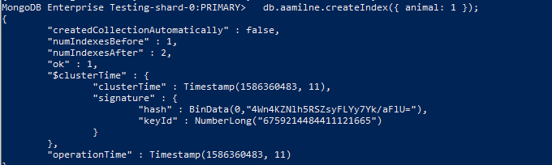
Winnie the Pooh and Databases too!

Slide 2
Creating a Collection
db.CollectionName.insertMany([{
You don’t have to go out of your way to set the collection and then fill it
Can also use insertOne if you’d prefer

Slide 3
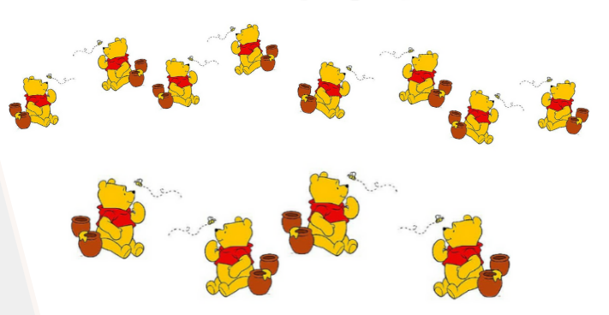
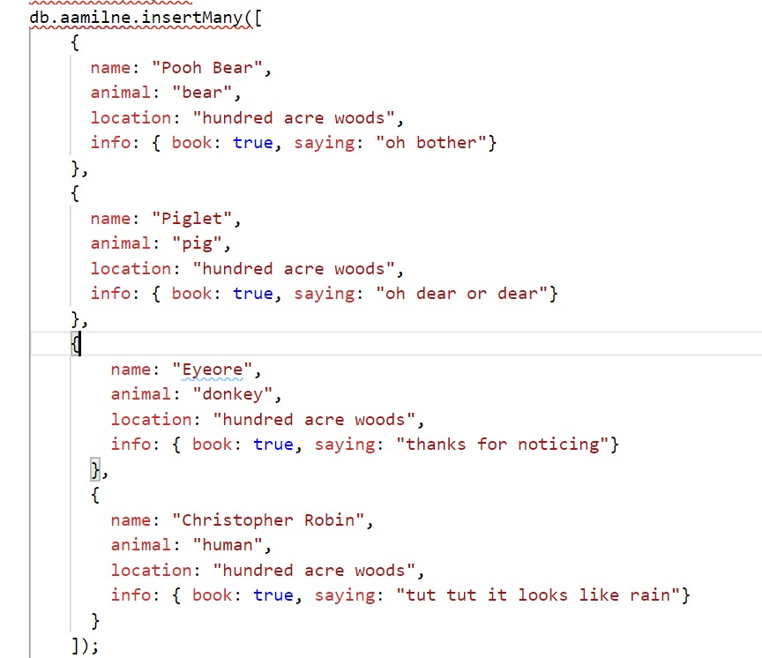
Keep yourself Organized!

Slide 4
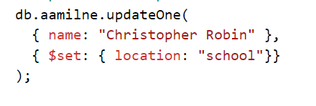
$set
Replace a value with something else
Use in conjunction with updateOne or updateMany

Slide 5
$unset
Delete a field
Use with updateOne or UpdateMany

Slide 6
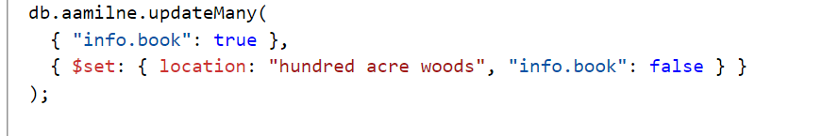
UpdateMany
db.CollectionName.updateMany(filter, update)
Filter -> how you select what you’re updating
Update -> the actual change you’re making
Using $set

Slide 7
CreateIndex
db.CollectionName.createIndex({field : 1)}
1 for ascending index
-1 for descending index
The number is NOT related to a value in the field

Slide 8
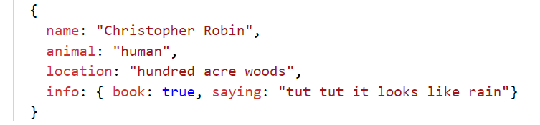
Embedded Fields
When you have more than one field in a category
Like sub-categories
Takes on the name of
CategoryName.FieldName

Slide 9
$rename
$rename: {oldName : “NewName”}
Can use it to change names or change positions in embedded fields

Slide 10


